Slide 1
Session 8
VALUES
RESPONSIBLE USE OF SPACE

Slide 2
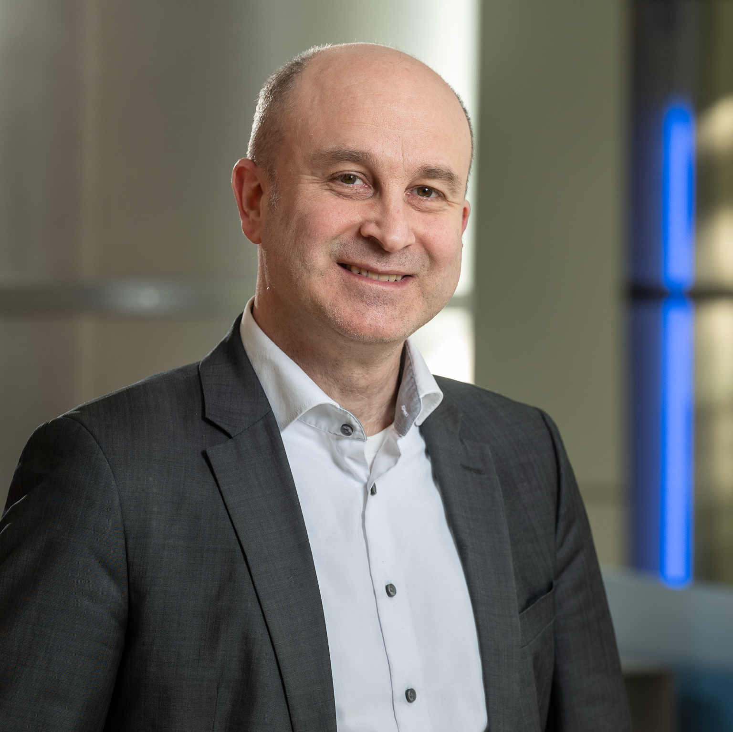
Holger Krag acquired his master in Aerospace Engineering at the University of Braunschweig, followed by a 4-year research period at the Institute of Aerospace System where he focussed on space debris modelling and surveillance. Today, he serves as the head of the Space Safety Programme in the Directorate of Operations, ESA-ESOC, in Darmstadt, Germany.
Krag joined ESA as an analysist in the Space Debris Office, where he worked on establishing risk models and an operational collision avoidance system and contributed to first space surveillance studies. In 2014, he took the position of the head of the Space Debris Office, which provided fundamental support to ESA’s Space Situational Awareness Programme. In 2019, he became the head of the programme and prepared the evolution into the new Space Safety Programme which was established at the Space19+ Ministerial.
His current duties comprise the implementation of the Programme and managing the resources delegated to the Programme Office in the areas of space weather, space debris, planetary defence, Clean Space and frequency management.
Holger Krag
Head of the Space Safety Programme
Directorate of Operations
European Space Agency (ESA)

Slide 3
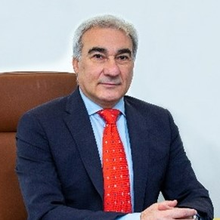
Sergio Buonomo is an electromagnetic engineer, with experience in the field of radiocommunications and technology. After completing his studies in engineering at the University of Naples, Italy, he began his professional journey in various industries specialised in radiocommunications and applied science.
In 1991 he ESA for eight years, where he contributed to several satellite projects and scientific research activities working on antennas and propagation modelling. He transitioned to the International Telecommunication Union (ITU) in 1999 and covered several positions on technical support activities.
Buonomo currently serves as Chief of the Study Groups Department. In this leadership position, he oversees and guides the work of study groups, facilitating collaboration and consensus-building among industry experts, government representatives, and technical specialists coming from all over the world.
Sergio Buonomo
Chief of Study Groups / Department
Radiocommunication Bureau
International Telecommunication Union

Slide 4
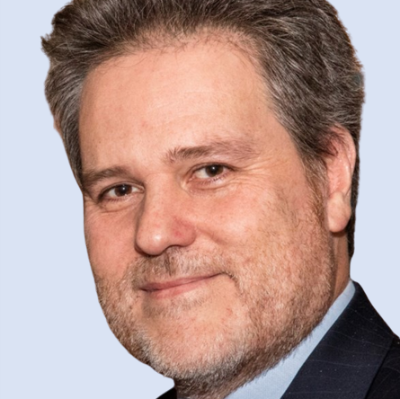
Piero Angeletti received a Laurea degree in electronic engineering from the University of Ancona in 1996, and a PhD in electromagnetism from the University of Rome “La Sapienza” in 2010.
Angeletti joined the European Space Research and Technology Center (ESTEC) of the European Space Agency (ESA), in 2004. In his current position as head of the Radio Frequency Payloads and Technology Division of the ESA Directorate of Technology, Engineering and Quality, he is leading a multidisciplinary team of renewed experts, which is responsible for RF payloads and technologies for space and ground applications, as well as propagation & wave interactions, and associated laboratory facilities.
His 25+ years' experience in RF systems engineering and technical management encompasses conceptual/architectural design, trade-offs, detailed design, production, integration and testing of satellite payloads and active antenna systems for commercial/military telecommunications and navigation.
Piero Angeletti
Head of Radio Freq Payloads & Technology Division
European Space Agency (ESA)

Slide 5
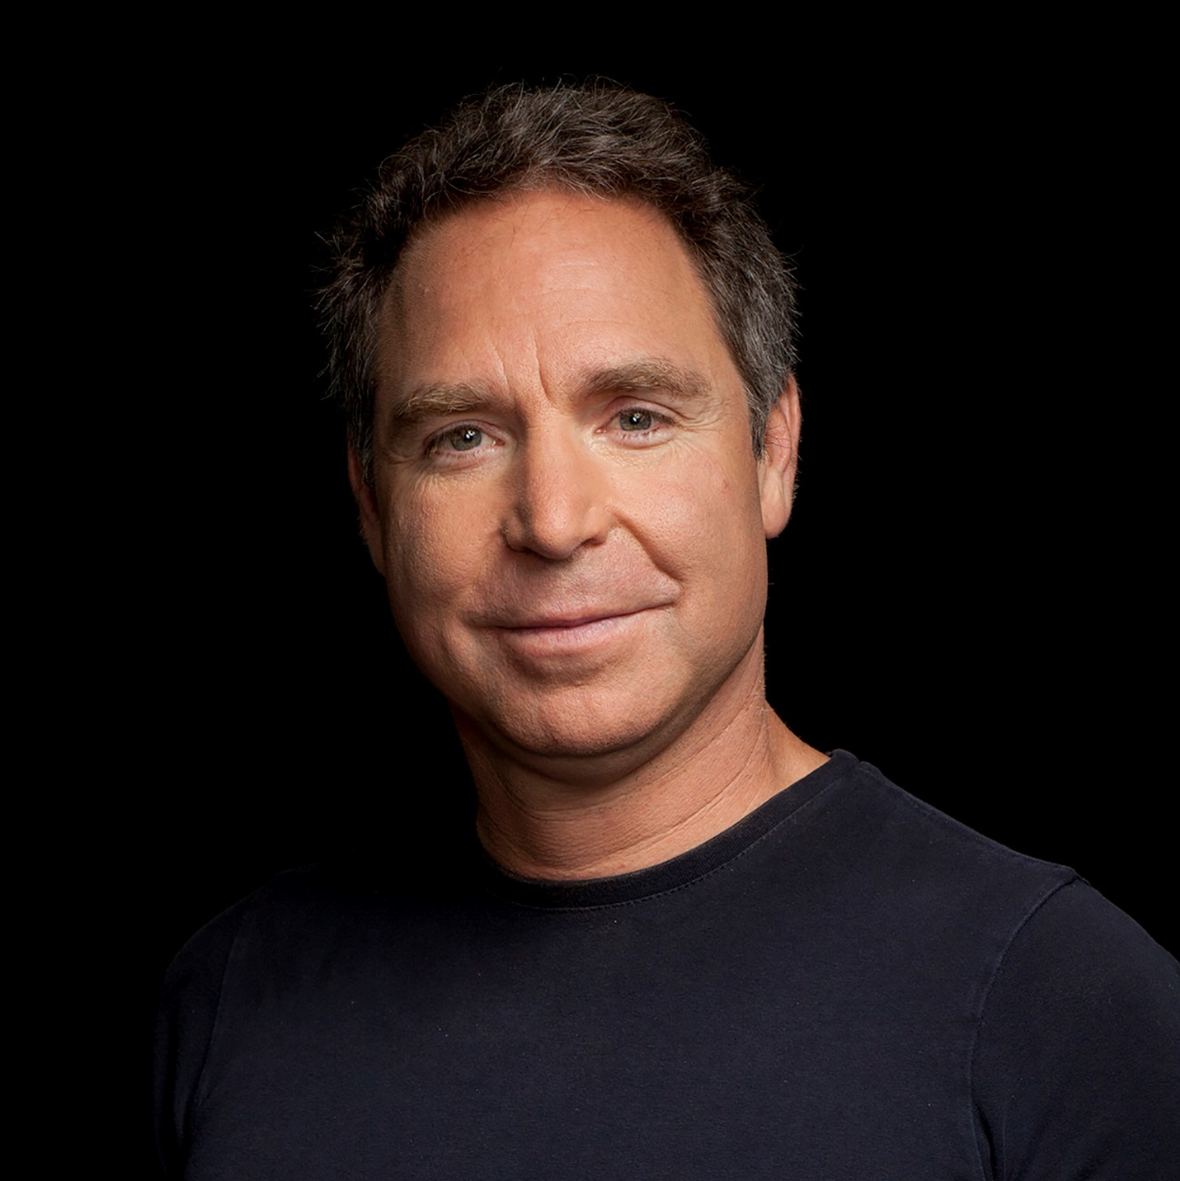
Greg Wyler is founder, chairman and CEO at E-Space, a global space company focused on bridging Earth and space with the world’s most sustainable low Earth orbit (LEO) satellite network. With E-Space he has re-imagined LEO satellite system design, manufacturing, economics and service delivery to overcome the limitations associated with legacy LEO systems.
Wyler is a recognised technology entrepreneur, engineer and visionary, with a proven track record of creating and growing innovative space companies. In 2007, he founded O3b Networks, followed by starting OneWeb in 2012. Both have proven successful, leveraging satellite technology to fuel global connectivity missions.
Wyler holds more than 35 patents related to the design, implementation and use of satellite communications technology.
Greg Wyler
Founder & CEO
E-Space

Slide 6
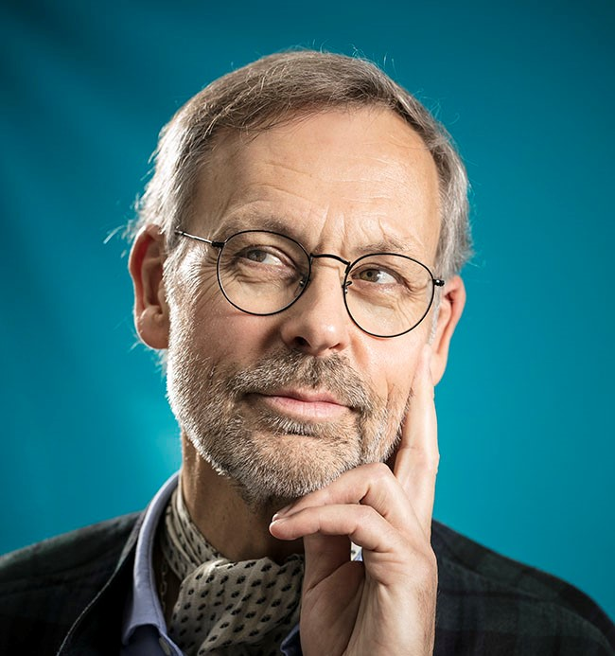
Jacques Arnould is an engineer in agronomy and forestry, has a Ph.D. in History of Sciences and a Ph.D. in Catholic Theology.
Arnould has been the French Space Agency (CNES) Ethics Adviser since 2001 and, for many years, has been collaborating with the International Space University (Strasbourg, France) as adjunct faculty on a variety of projects. Additionally, he is the president of the scientific committee of the Air and Space Museum of Le Bourget (Paris, France) and the Secretary of the College of French Terminology for Astronautics.
Arnould is the recipient of the Labruyère Prize from the Académie Française, the Audiffred Prize from the Académie des sciences morales et politiques and was selected for the International Astronautical Federation Hall of Fame 2022.
Arnould is the author of several books, including Space Activities: Icarus’ Second Chance. The Basis and Perspectives of Space Ethics, Springer, 2011 and God, the Moon, and the Astronaut, ATF Theology, 2016.
Jacques Arnould
Ethics Adviser/Expert éthique
CNES

Slide 7
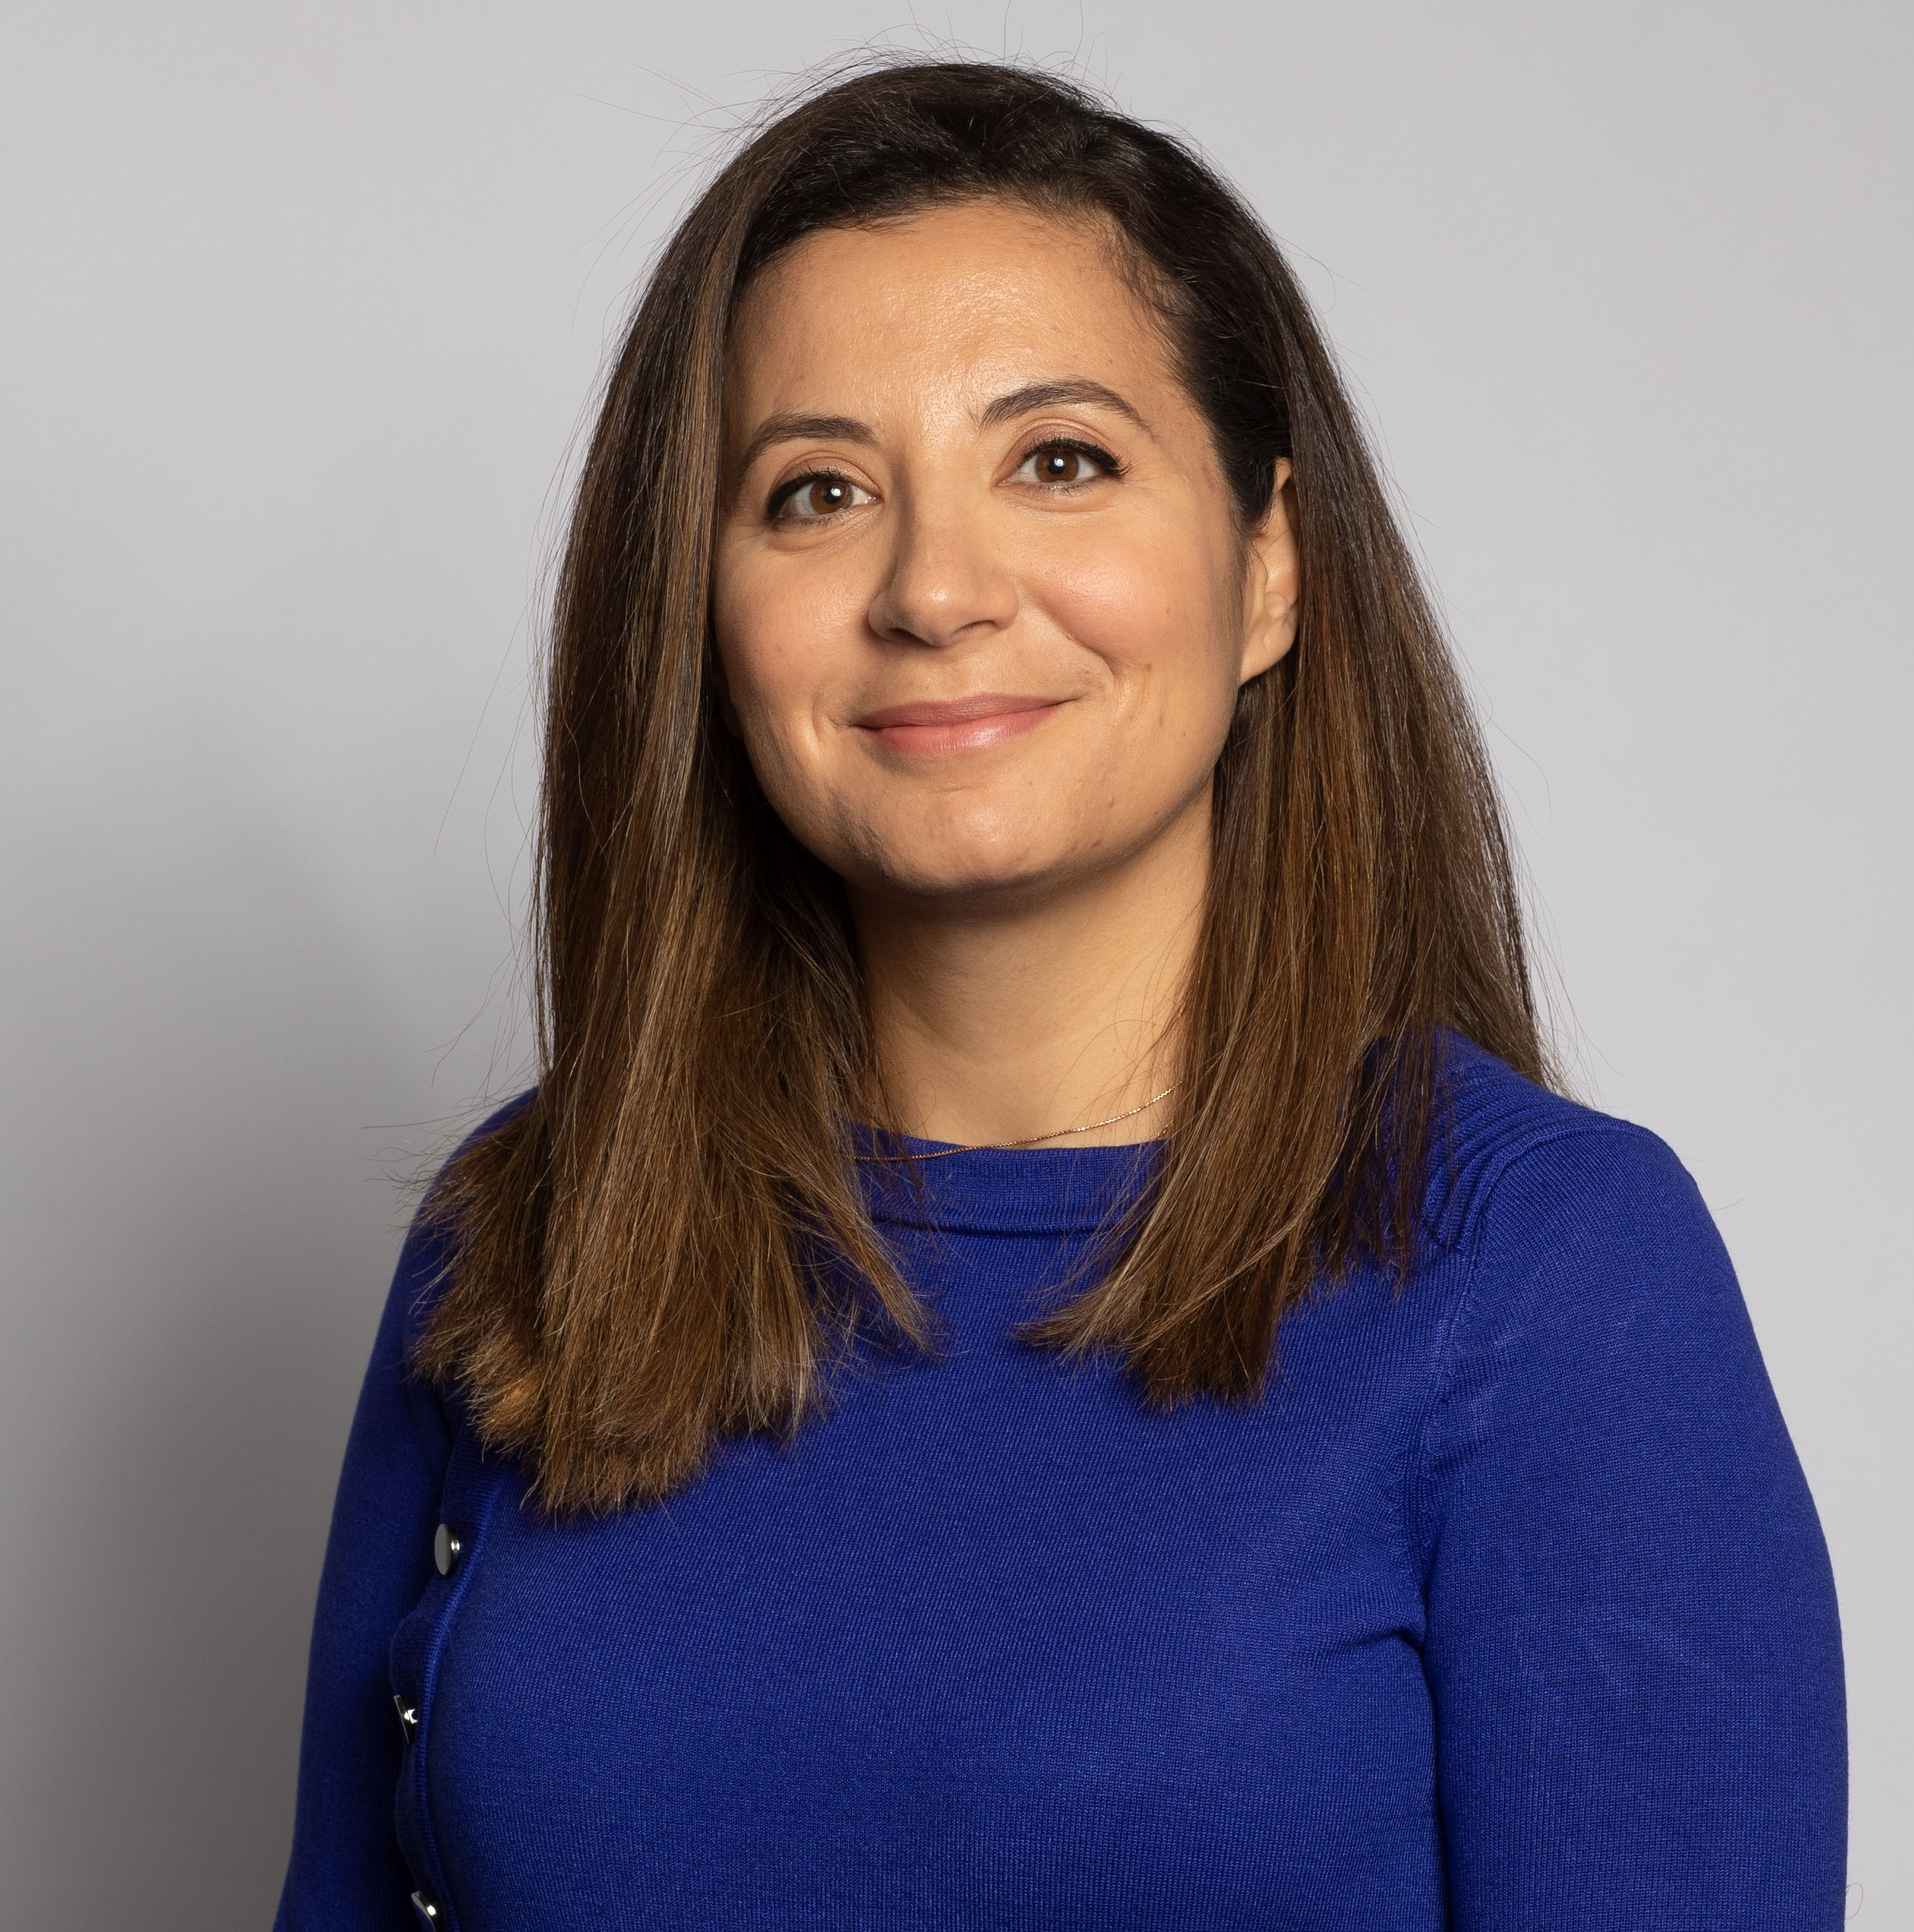
Yasrine is a professional with 17 years in the space industry, specializing in innovation, communication systems, and entrepreneurship. She currently leads the Advanced Concepts and Technologies department at Viasat (former Inmarsat), where she has created and led several innovative mission concepts. She's also been key in building public-private partnerships with space agencies worldwide. Her academic accolades include an Executive MBA from Cambridge and two Masters of Science degrees.
Yasrine Ibnyahya
Senior Director, Advanced Concepts and Technologies
VIASAT

Slide 8
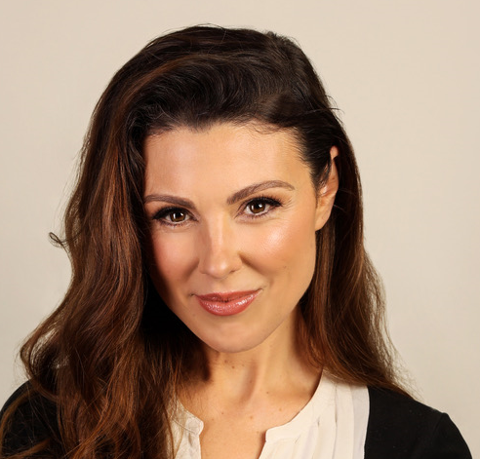
Lisa Burke is an experienced broadcaster having spent the bulk of her career presenting live television with Sky News, the BBC, Channel 4, Fox News, RTE (Ireland) and RTL (Luxembourg). Her reporting has covered national and international assignments, documentaries and radio.
Other writing includes children's science books. Burke has been a science consultant and author with Dorling Kindersley since 2005. She studied Natural Sciences at Cambridge University, gaining a double first.
In Luxembourg, Burke created RTL Today which has become the biggest English news platform in the country. Now, she hosts and produces a weekly radio show (also available with video) and podcast: 'The Lisa Burke Show'. She is also a host and moderator, covering TED talks, all Luxembourg Space Agency work, finance, health, entrepreneurship, tech, science, European Institution events and many more.
Lisa Burke
Presenter/Moderator

Slide 9
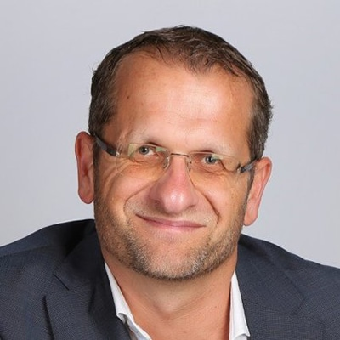
Olivier Van Duüren is an international public speaker, executive whisperer, transformer, active investor and author.
After 22 years in senior global executive positions at Microsoft, he left to start The Dualarity and the Visual Senseformers to help organisations to transform while performing.
Olivier Van Duüren
Presenter/Moderator

Slide 10
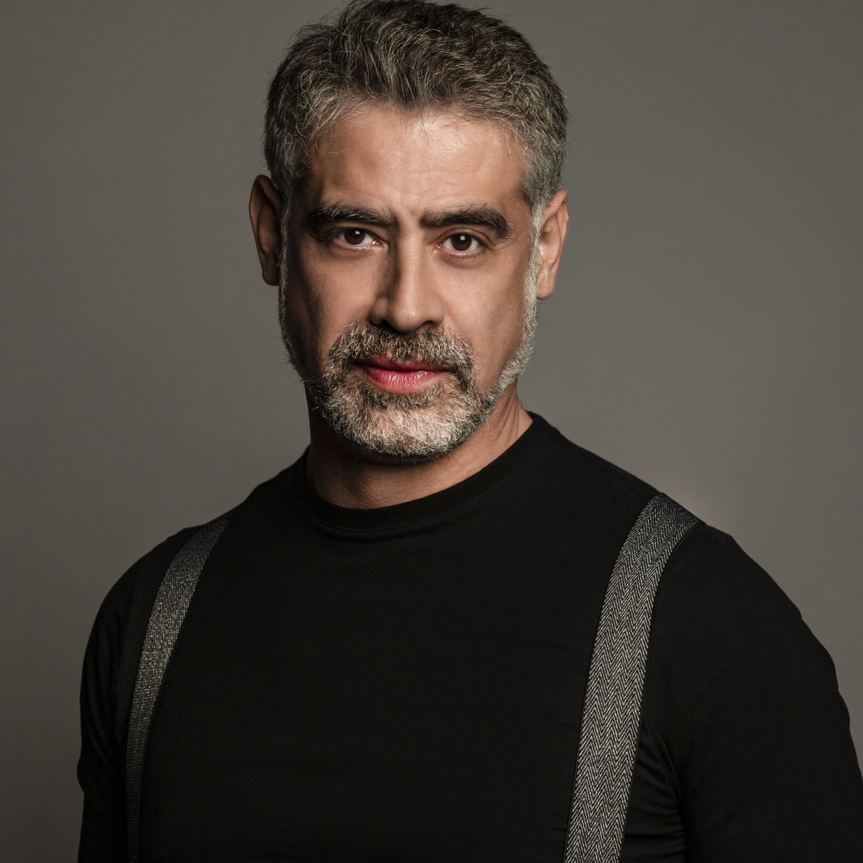
Journalist and author. He regularly writes for Wired Italy, L’Espresso, Italian Tech and Il Sole 24 Ore, magazines for which he curates the digital culture, videogame criticism, e-Sports and aerospace sections. In 2022 he published the AstroWired. He also serves as UNICEF Italy’s testimonial.
Journalist and author, Emilio Cozzi is one of the best known Italian scientific communicators with expertise in technological innovation, Space, e-sports and videogame culture. He is present both live on radio and television, on newspapers, magazines, books, and on the web. He regularly writes for Wired Italia, L’Espresso, Italian Tech, Il Corriere della Sera and Il Sole 24 Ore. Since 2019 he’s been in charge of the Space Economy section for Forbes Italy. He is co-author and host for Forbes’s weekly program Space Economy which airs on Sky 511 and Tivùsat 61. In 2020 he became scientific consultant for the documentaries Starman and Space Beyond, both dedicated to ESA astronaut Luca Parmitano’s Beyond mission. He is head of content for AstroPaolo, former ESA astronaut Paolo Nespoli’s new business venture.
Since 2021 he’s been co-author and host of a Space divulgation program produced by Libero Produzioni TV, namely Space Walks which airs on Rai 4 and Rai Play. Since 22nd January 2022, the program is also available on Rai Italia. In 2022 he published the AstroWired podcast which addresses the relationship between space and science fiction. Amazon describes it as the “revelation podcast of the year”. He also serves as UNICEF Italy’s testimonial Among his books: Ti racconto un film (2005, with Roberto Escobar, Raffaello Cortina Editore), Il ritiro sociale negli adolescenti (2019, edited by Matteo Lancini, Raffaello Cortina Editore), Io sono Pow3r, (2020, with Giorgio Calandrelli , Salani Editore), L’esplorazione dello spazio (2021, Le Scienze / La Repubblica) and Spazio al Futuro (2021, Bfc Books-Telespazio / Leonardo Com
Emilio Cozzi
Presenter/Moderator

Slide 11
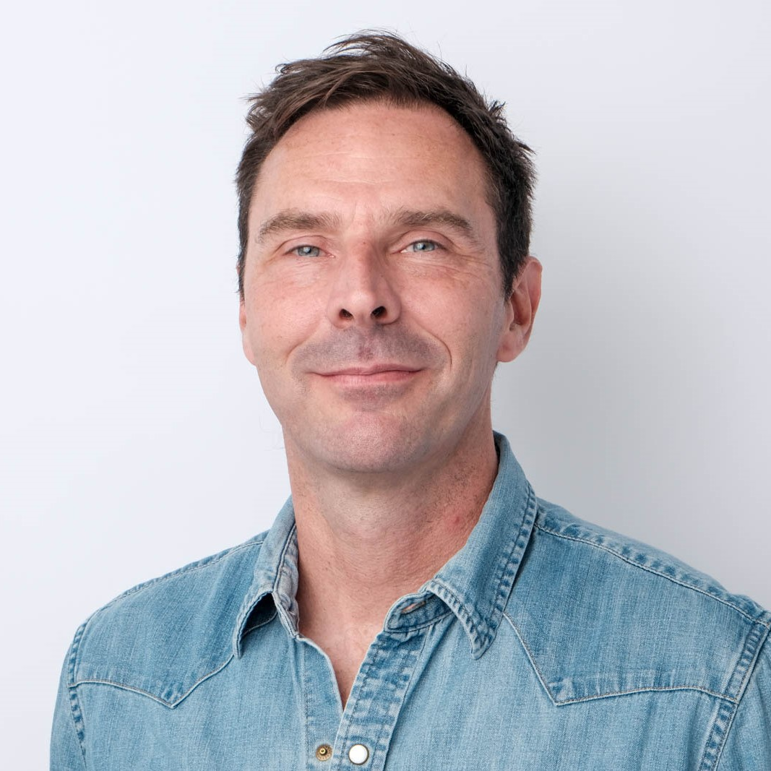
Kristof Braekeleire is a graphic facilitator, strategist, illustrator and author.
He spent twenty years at Hewlett-Packard, ending up at the global headquarters where he was trained and seasoned as a visual strategist. In 2017 he started up JIXSO, a visual facilitation business, and the Visual Senseformers.
Kristof Braekeleire

Slide 12
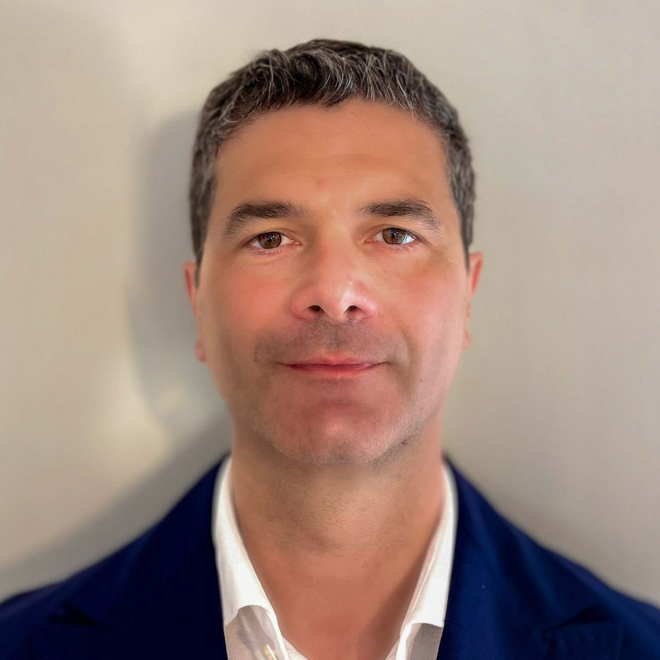
Domenico Mignolo received a Master's Degree in computer science engineering with specialisation in electronics and telecommunication in 1998. In 2011, he received the Executive Master in business administration from Erasmus School of Management (RSM).
In 1999, he joined Alenia Spazio (IT), where he performed research on satellite systems communication protocols, two-way satellite user terminals and coordinating the DVB-RCS standardisation activities. In 2002, he joined the European Space Agency, Research and Technology Centre (ESTEC) (Noordwijk, the Netherlands) where he is now head of Ground Segment technologies and products section as well as deputy for the ARTES Core Competitiveness programme in the Telecommunication and Integrated Application Directorate.
At ESA, he has been technical officer of several two-way satellite systems, ground and user segment study and development projects and standardisation activities. He also contributed to the initiation of several new programmes and Public Private Partnership (PPP) projects.
Domenico Mignolo
Head of Ground Segment Section
Directorate of Telecommunications & Integrated Applications
European Space Agency (ESA)

Slide 13
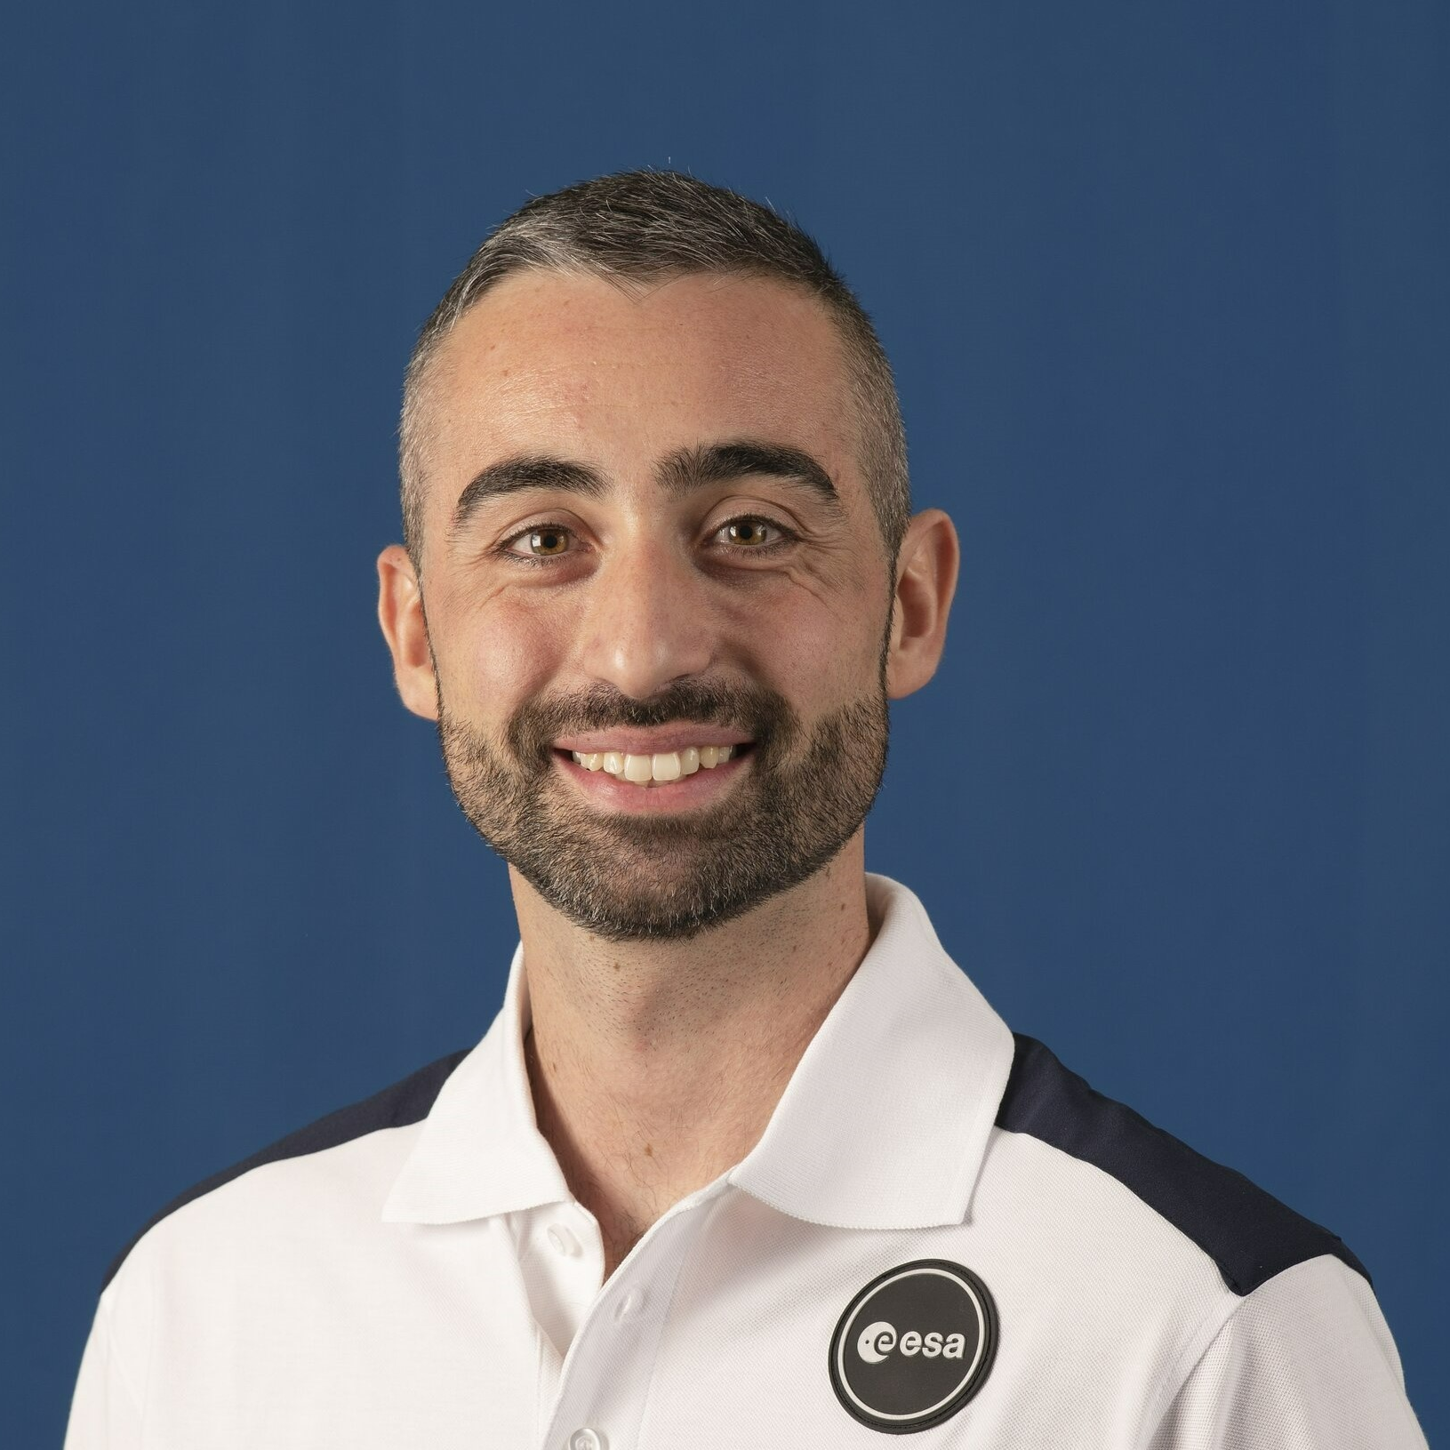
Andrea Patassa (Spoleto, May 6, 1991) is a test pilot for the Italian Air Force, as well as a member of the European Space Agency (ESA) Astronaut Reserve.
In 2010, he began his training at the Italian Air Force Academy, obtaining a bachelor's and master's degree in Aeronautical Sciences. In 2015, he trained as a military pilot in the Euro-NATO Joint Jet Pilot Program (ENJJPT) at Sheppard Air Force Base in Texas. After completing his training, he operated as a Eurofighter Typhoon fighter pilot and participated in missions in Lithuania and the Middle East.
In 2022, he attended the Experimental Test Pilot Course with the United States Air Force at Edwards Air Force Base in California, where he obtained a master's degree in Experimental Flight Test Engineering. During this period, he successfully passed the ESA Astronaut Selection, earning a place in the Astronaut Reserve.
Currently, he is employed at Pratica di Mare Air Base, where he is involved in the development and testing of various aircraft for the Italian Air Force. He has accumulated a total of approximately 1000 flight hours on over 30 different military aircraft.
Andrea Patassa
Astronaut
European Space Agency (ESA)

Slide 14
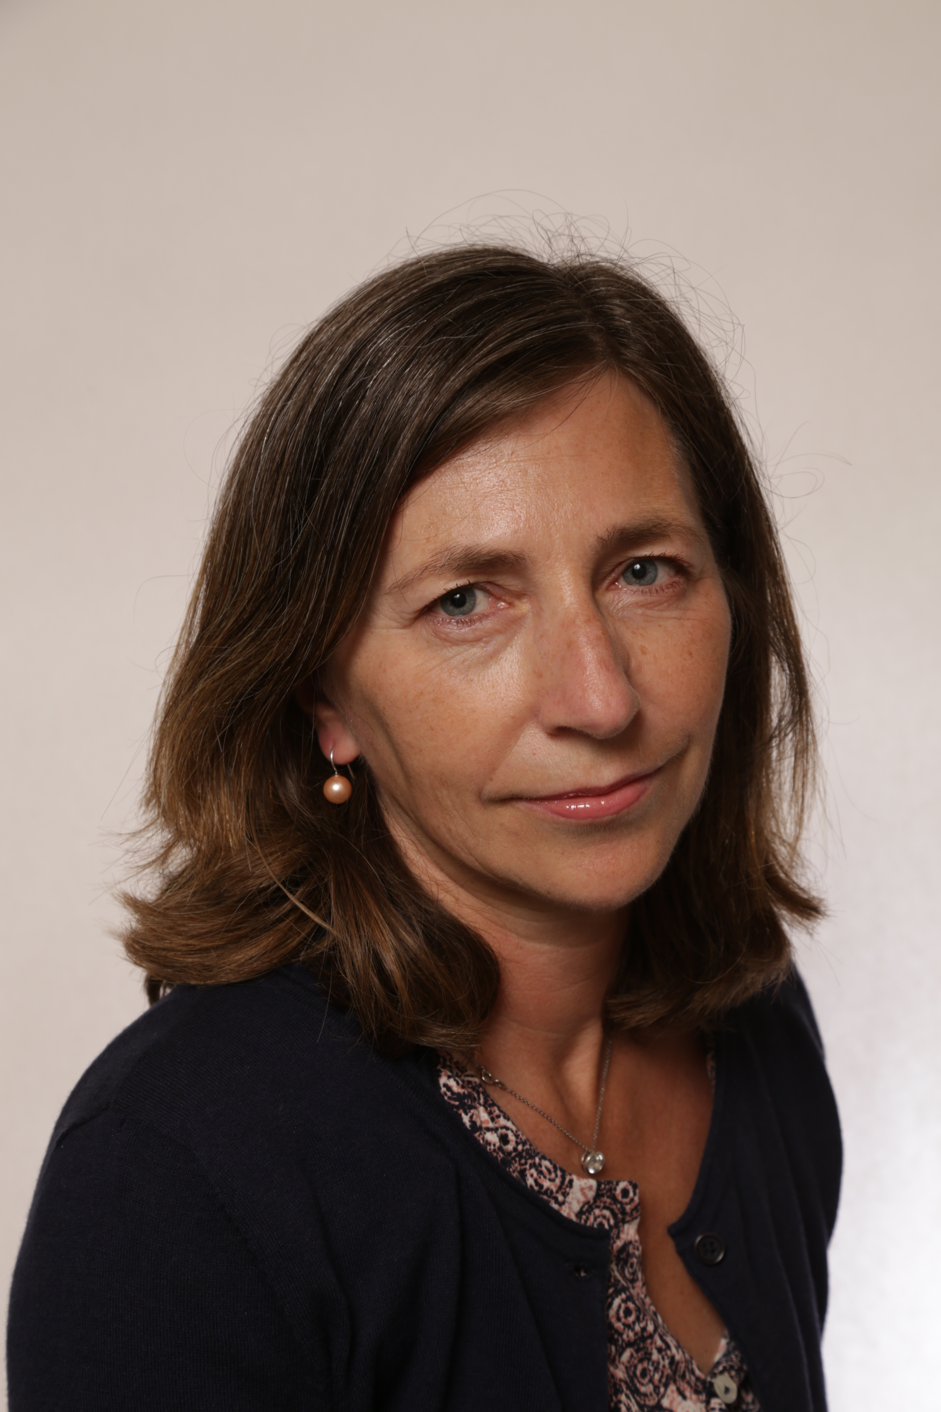
Since April 2011, Gisela Suess has served as the head of the Institutional Law Division, Legal Services Department of ESA. Previously, she was ESA's administrator in the Human Resources Department and previously an attorney at Law, Willkie Farr & Gallagher in Paris.
Suess has served as a teacher at the International Space University and in the frame of the European Centre of Space Law summer courses and a teacher in the framework of the Master European Law at the Panthéon Sorbonne University, among other positions in law.
Suess holds first and second state examinations in law and a Doctorate in European law, with distinction.
Gisela Suess
Head of the Legal Services Department
European Space Agency (ESA)

Slide 15
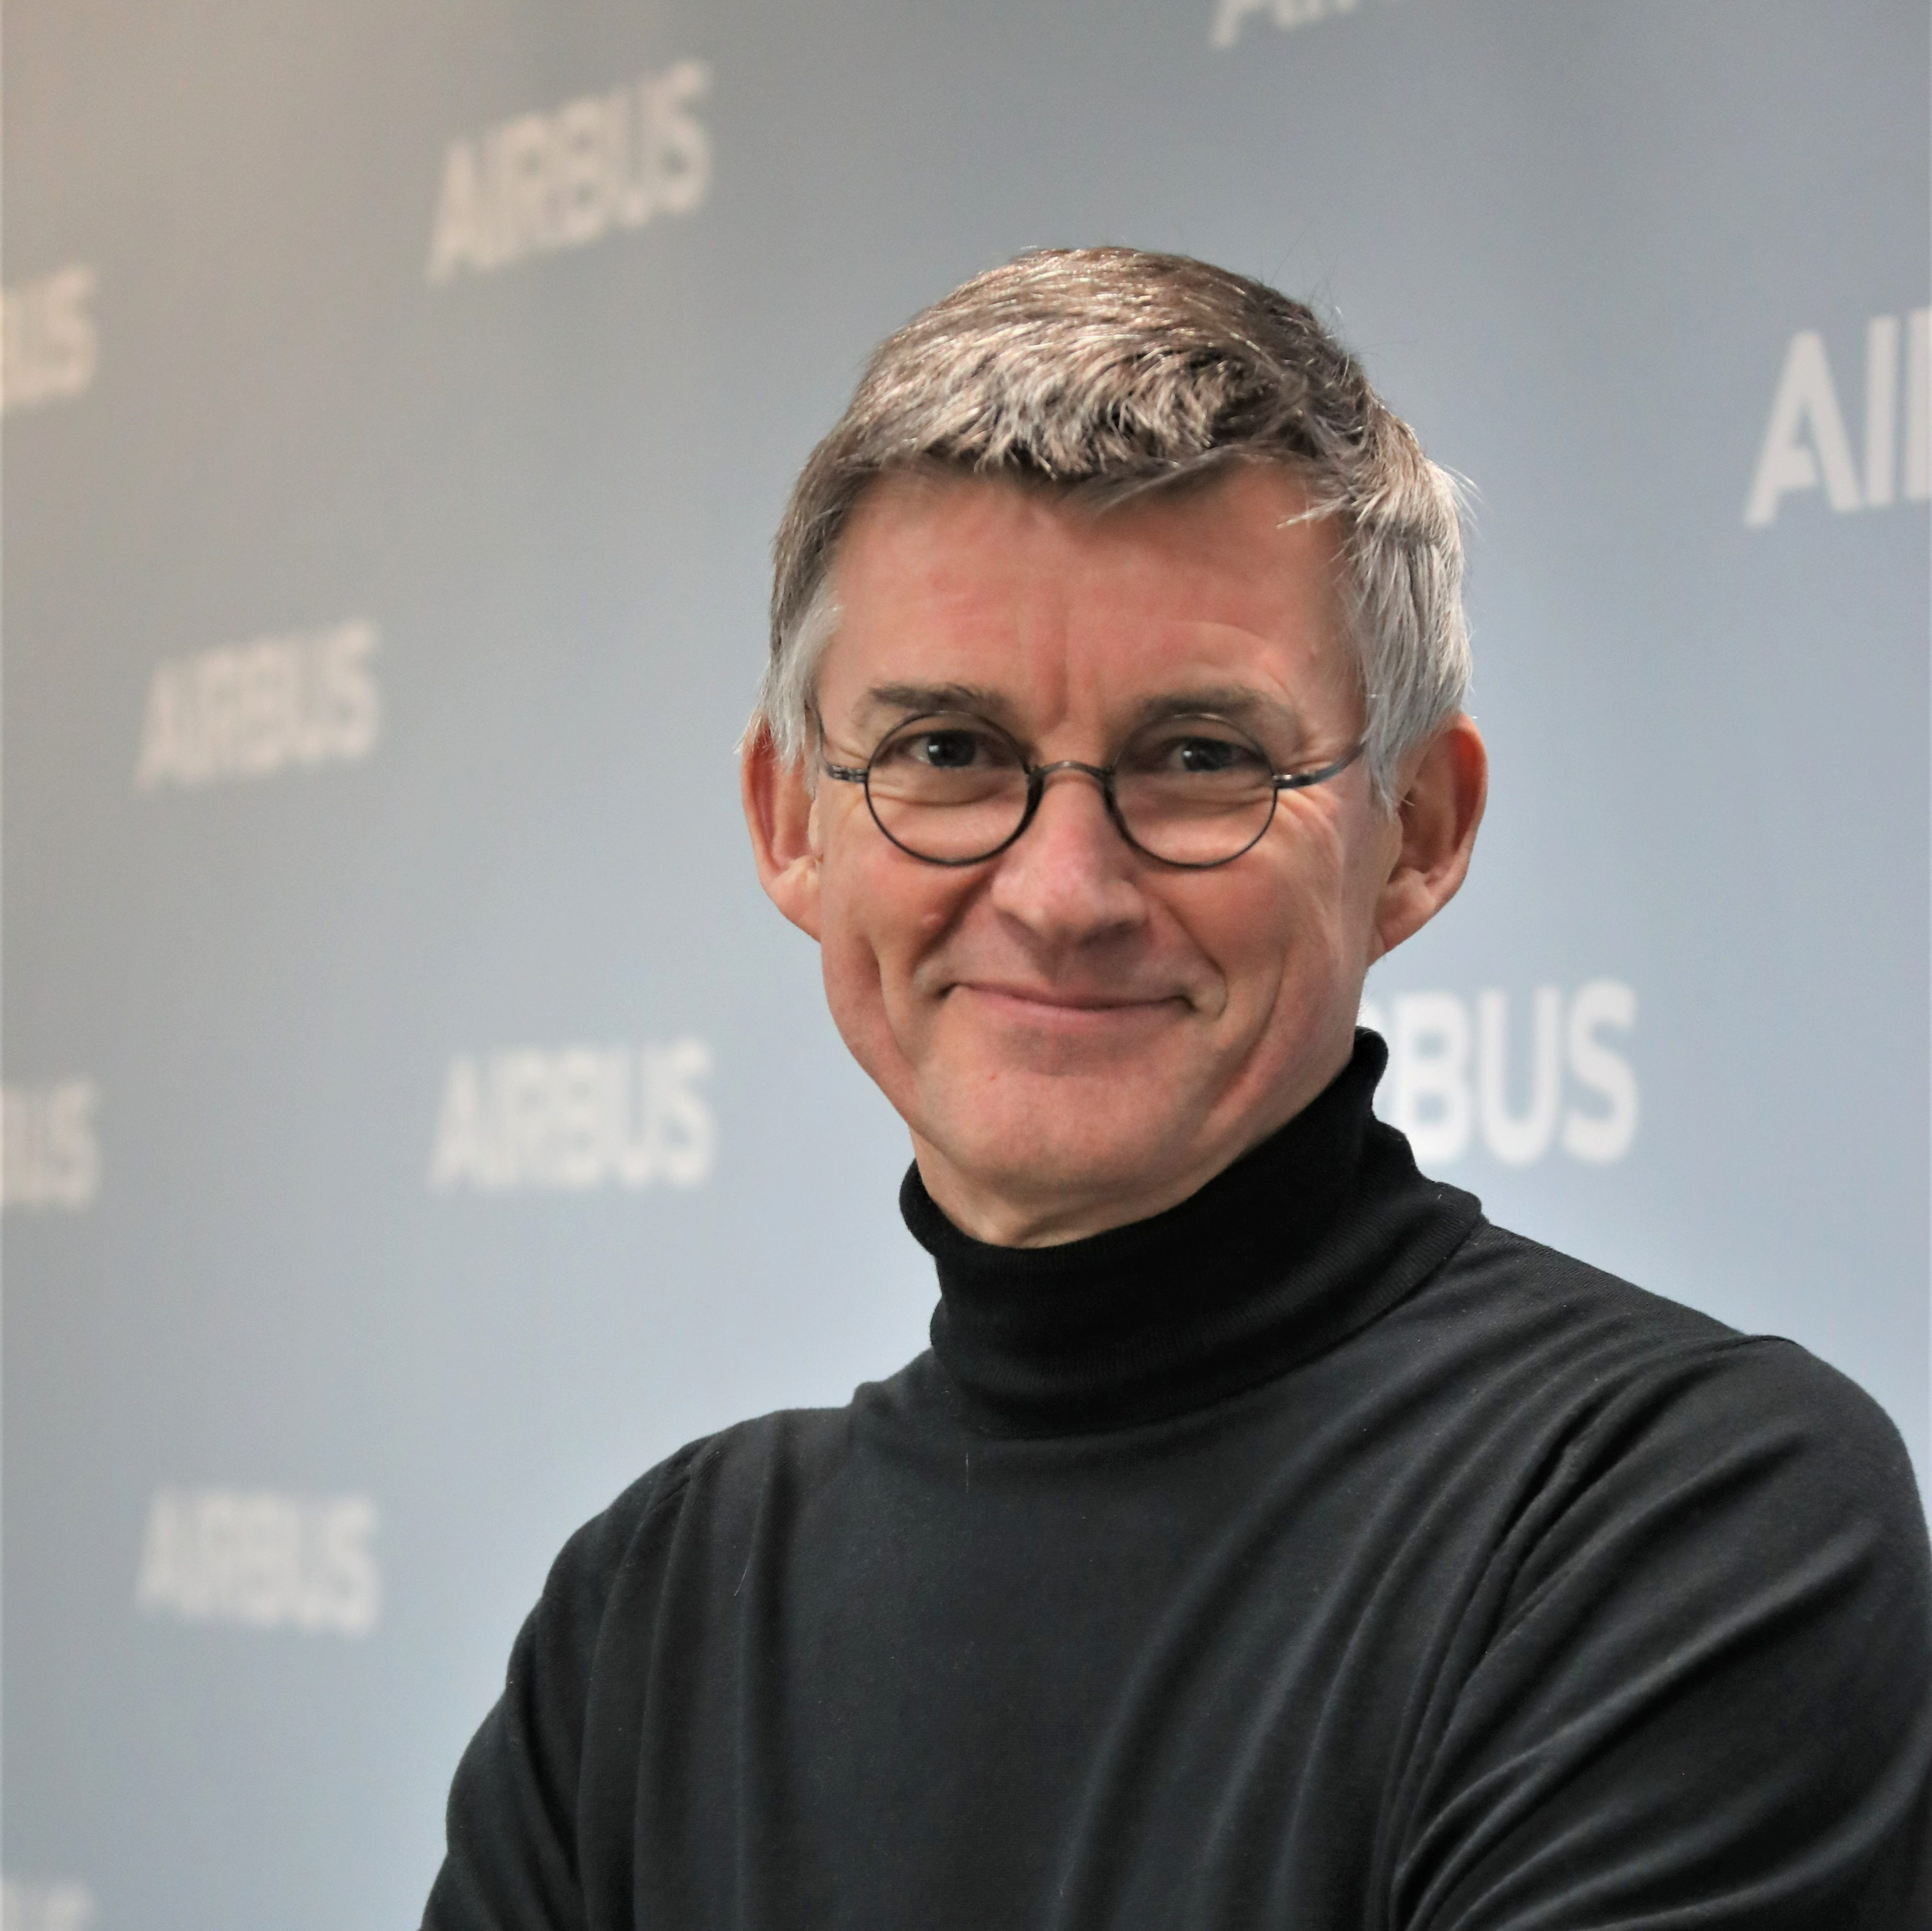
François Gaullier has served as head of Telecommunications and Navigation Systems at Airbus since 2019. He has been instrumental in delivering satellites and systems with the highest quality standard, boosting innovation and industrial efficiency in his organisation.
Gaullier brings more than 25 years of experience to the space business, where he has held a variety of roles over the years within engineering, customer support, product development and as a director.
Gaullier graduated with a degree in aeronautical and space engineering (ISAE-SUPAERO 1988).
François Gaullier
Head of Telecommunications and Navigation Systems
Airbus Defence and Space

