Slide 1
Session 6
ENABLERS
TECHNOLOGICAL ENABLERS

Slide 2
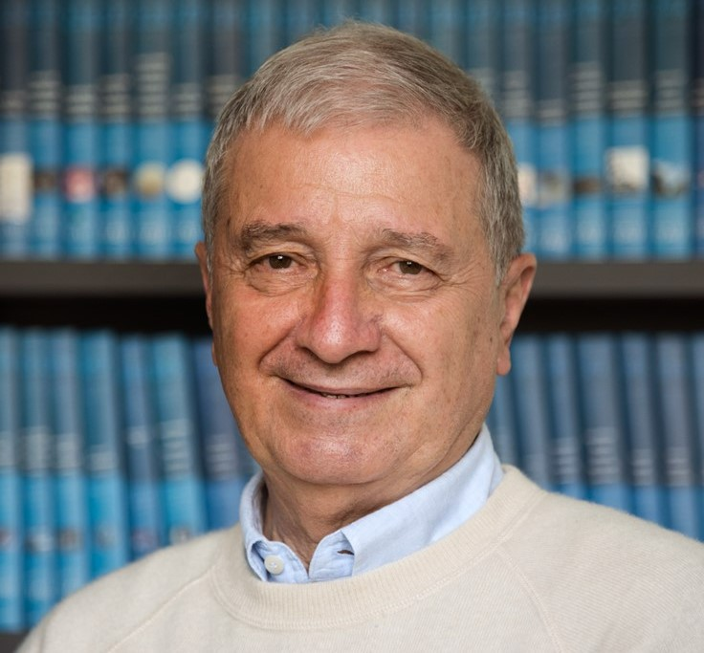
Piero Benvenuti has previously served as full professor of high energy astrophysics at the University of Padova and Director of the Center for Space Studies and Activities "G. Colombo", also at Padova. He was also previously project scientist of the astronomical satellite IUE (Madrid) and of the Hubble Space Telescope European Coordinating Facility (Garching bei München) at the European Space Agency.
Benvenuti has served as the president of the (Italian) National Institute for Astrophysics (INAF) and was the commissioner of the Italian Space Agency (ASI). From 2015 to 2018, he held the position of general secretary of the International Astronomical Union (IAU).
In 2022 Benvenuti was appointed Director of the IAU Centre for the Protection of Dark and Quiet Sky from Satellite Constellations Interference (CPS). He is the IAU Representative to the UN COPUOS and also serves as Professor Emeritus of the University of Padova.
Piero Benvenuti
Director of the Protection of Dark & Quiet Sky from Satellite Constellations Interference
International Astronomical Union

Slide 3
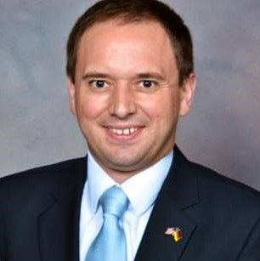
Laurent Jaffart is currently the head of Strategy, Corporate and New Business Development of Airbus Defence and Space for Space Systems. Formerly, he was the head of Constellation and Future solution for Space Systems Marketing and Sales. Jaffart is also member of the Board of Airbus OneWeb Satellites LLC which designs and manufactures constellation satellites, amongst other opportunities.
Jaffart leads a trans-national team based in France, Germany and in the UK. The aim of his organisation is to define and implement the strategy for Airbus Space, bringing new solutions and innovation to the market.
Jaffart holds a Master's in national resources strategy from the National Defense University in Washington DC USA (2013), two Masters in business administration from the former ESC Reims (Reims Management School - France) and Dublin City University (2002) and a Bachelor of Sciences (Hons) in European Business and Technology from the University of Brighton in the UK (2000).
Laurent Jaffart
Vice President - Head of Strategy, Corporate & New Business Development Space Systems
Airbus Defence and Space

Slide 4
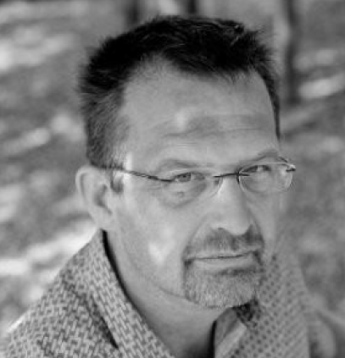
Geert Adams holds a civil engineering degree from the University of Ghent and a postgraduate in business management from the Catholic University of Leuven.
Adams started his career at Alcatel Bell, as a design engineer involved with the R&D of ATM networks. Later he joined KPN Belgium (former Unisource Belgium), where as sales engineer manager, his responsibilities covered network designs for Voice, Data and Internet Services for large customers.
From 2001, Adams joined Newtec taking up the programme management of Newtec’s 2 Way-Sat DVB-RCS system. By the end of 2019, iDirect and Newtec merged into ST Engineering iDirect. Within ST Engineering iDirect (Europe) Geert Adams holds the position of VP of R&D programmes reporting directly to the CTO Frederik Simoens.
Geert Adams
VP R&D Programs
ST Engineering iDirect

Slide 5
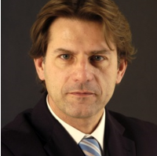
After graduating in aeronautical engineering at the Politecnico of Milano and following a brief period at Aermacchi, Roberto Aceti joined ESA-ESTEC in 1989 where he served as project manager and programme manager for ten years.
In 1999, Aceti was called in the Compagnia Generale dello Spazio (now OHB Italia) as marketing director and, within a decade, he reached the top of the company: in 2013 he was appointed as chief executive officer, a position he still holds today.
Roberto Aceti
CEO
OHB Italia

Slide 6
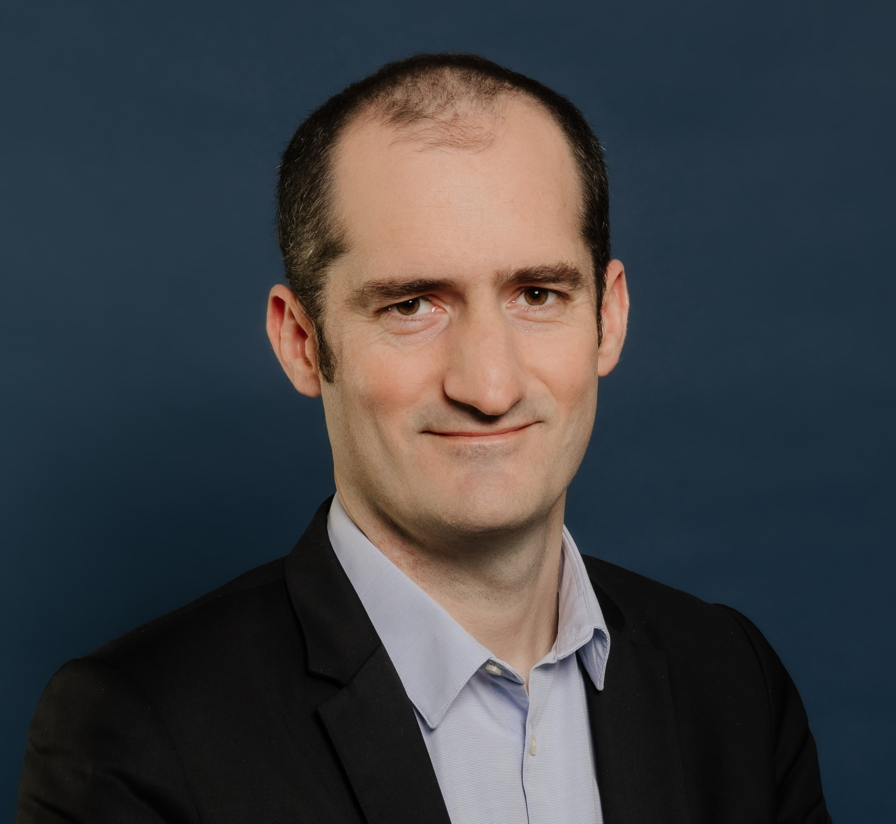
Marc-Henri Serre is senior vice president of Thales Alenia Space's Telecommunications Business Line. Thales Alenia Space delivers cost-effective solutions for telecommunications, navigation, Earth observation, environmental management, exploration, science and orbital infrastructures.
He graduated from Ecole Polytechnique in 2005 and from Ecole Nationale des Ponts et Chaussées in 2008, before beginning his career at the French Ministry of Finance and then in prime Minister staff. Serre then joined Thales Alenia Space where he was appointed Director, where he became VP Domain Observation and Science France.
Serre has extensive experience in space activities, particularly in engineering, product policy, customer relationship, commercial offers and project management domains.
Marc-Henri Serre
Senior Vice President of Telecom Business Line
Thales Alenia Space

