Slide 1
Session 4
ENABLERS
NOVEL SPACE CAPABILITIES FOR EMERGING CONNECTIVITY NEEDS

Slide 2
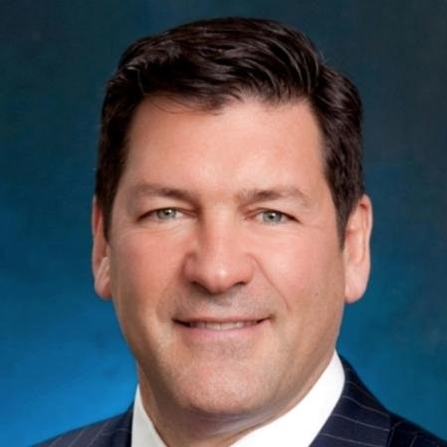
Sean Wallace is the executive vice president and chief financial officer (CFO) for AST SpaceMobile. Wallace joined AST from Cogent Communications, the largest wholesale ISP in the world, where he was the chief financial officer. Prior to becoming a CFO for telecommunications companies, Wallace had a long and distinguished career as a senior banker focusing on Asia and the telecommunications industry. He was the group head for Corporate and Institutional Clients for Standard Chartered Bank leading the global wholesale business for this bank which focuses on Asia, Africa and the Middle East. Wallace was also the co-head of Investment Banking, Asia Pacific, for JP Morgan. As a coverage banker, Sean ran the satellite coverage business at JP Morgan and led transactions for companies such as Iridium, PanAmSat, Orbital Sciences, AsiaSat and others. Wallace has an AB in history and economics from Harvard College and an MBA from Harvard Business School.
Sean Wallace
Executive Vice President &
Chief Financial Officer
AST Space Mobile

Slide 3
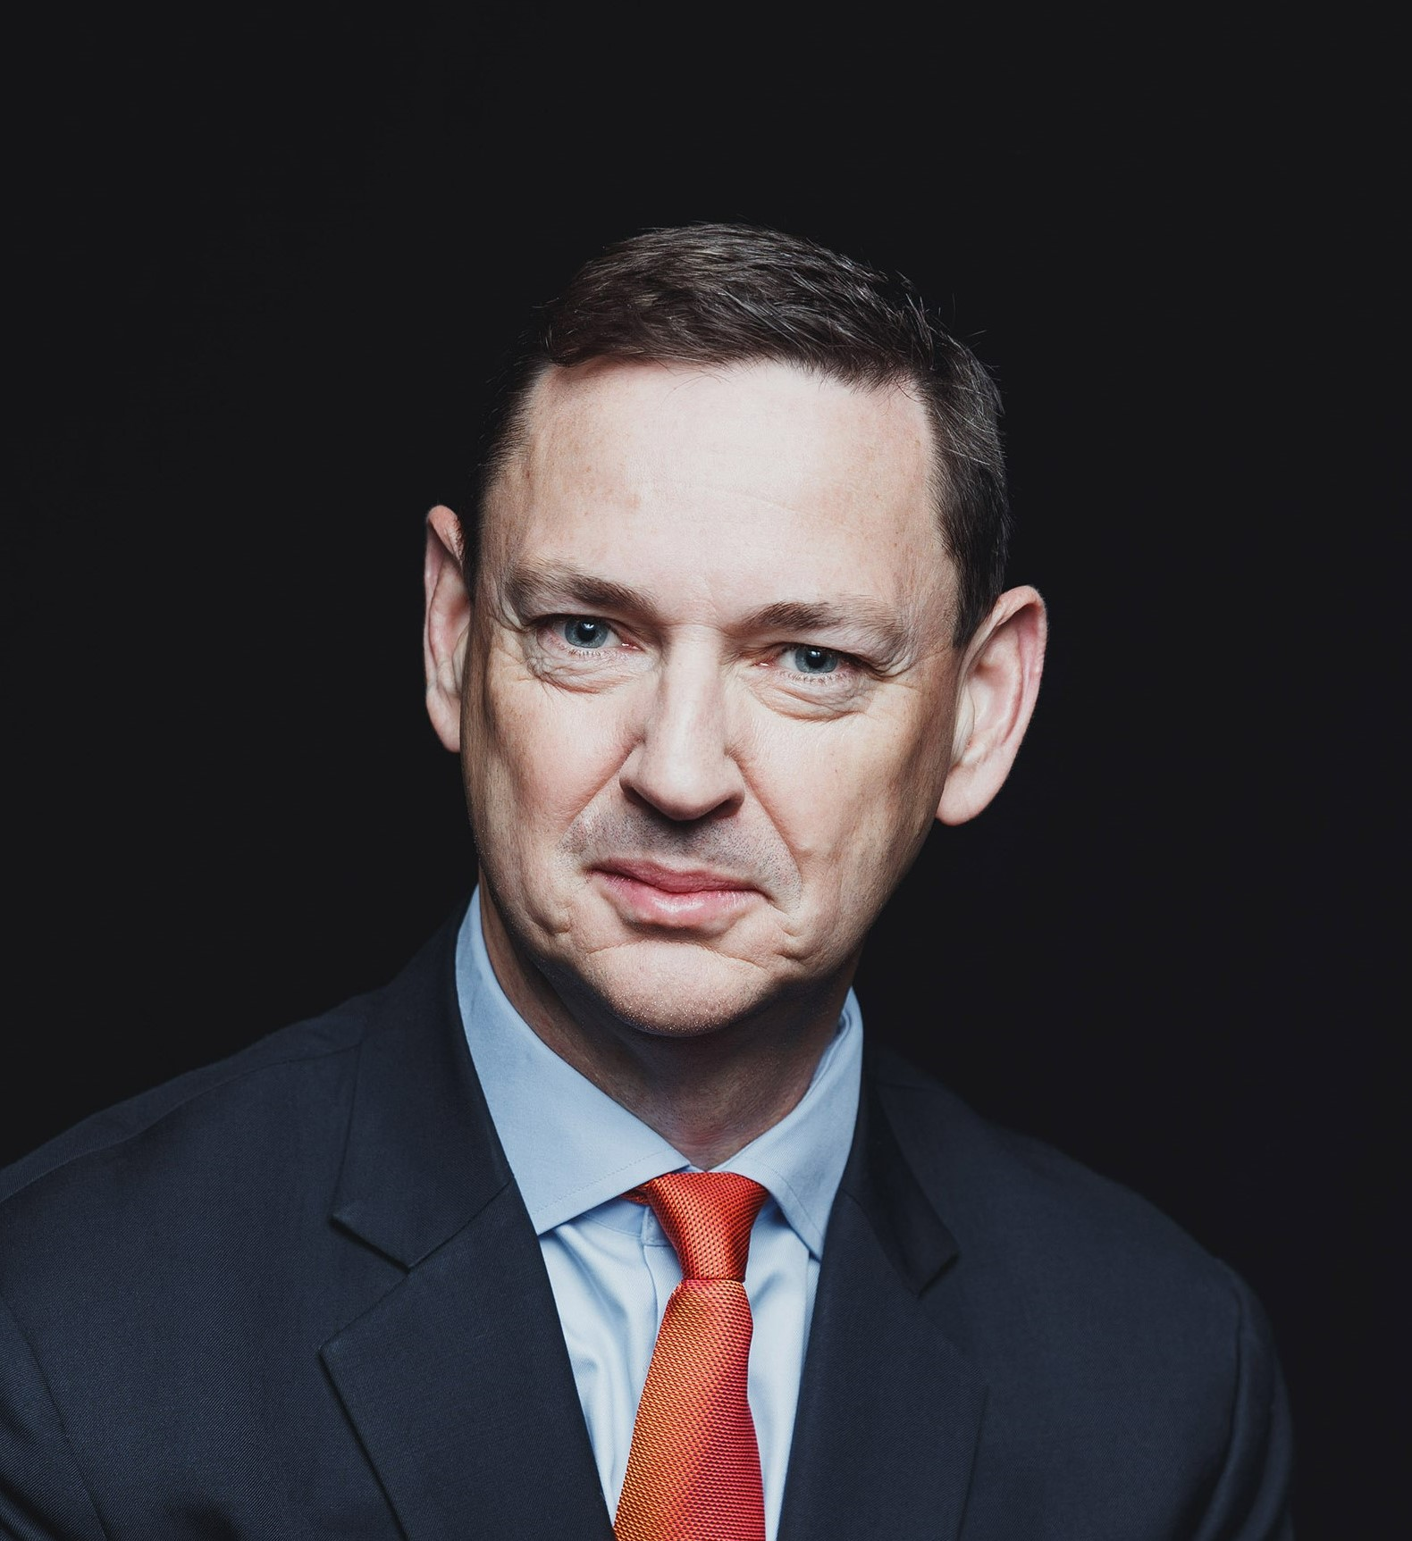
Conor Carroll is a Global Sales Leader with more than 30 years of experience driving market share, revenue and profitability growth in the international telecoms and IT sectors across both mature and emerging markets. His formative career was grounded in corporate development strategy for industry giant, Cable & Wireless and Russian telco, where he led large-scale acquisitions and capital markets fundraising. In 2007, Carroll joined Tata Communications and spent 11 years with the group in a series of senior sales roles. This included leadership of the Global Carrier Solutions business across multiple channels, encompassing APAC, India, Americas and Europe, which culminated in his leadership of Tata’s EMEA business. In 2020, he joined Vodafone Business to lead the Northern Europe team for Vodafone Global Enterprises managing a team of 150 sales and customer success management professionals. In 2021, Conor took on a newly created Market Development role to drive customer acquisition programs across Public Sector with particular focus to drive the Vodafone Business portfolio acquisition strategy.
Conor Carroll
Head of Market Development
Vodafone

Slide 4
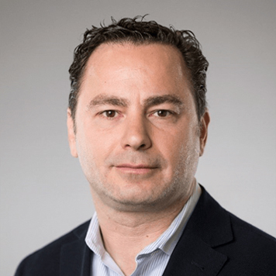
Massimiliano Ladovaz is responsible for the entire end-to-end system technology ecosystem at OneWeb including launch systems, R&D, design, manufacture and delivery of OneWeb’s satellite ground network and user terminals. He oversees the entire spectrum engineering division and is also planning the next generation of system infrastructure, aspiring to achieve outstanding technical solutions and innovation for OneWeb’s Gen2 space-based connectivity network. OneWeb is the global connectivity platform powered from space, headquartered in London, enabling connectivity for governments, businesses, and communities. Owned by global consortium of shareholders including: Bharti Global, the UK Government, Eutelsat, Softbank, Hughes and Hanwha, OneWeb is implementing a constellation of low Earth orbit satellites with a network of global gateway stations and a range of user terminals to provide an affordable, fast, high-bandwidth and low-latency communications service that is connected to the IoT future and is a pathway to 5G.
Massimiliano Ladovaz
Chief Technology Officer
OneWeb

Slide 5
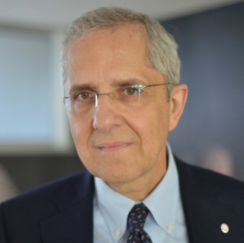
Luigi Pasquali has been the coordinator of Leonardo Space Activities and Telespazio Chief Executive Officer since February 2013. He holds a degree in electronic engineering and has attended courses in finance and business management. Pasquali served the Italian Army as officer in the Technical Corps, where he was in charge of telecommunications. He began his career at Selenia as system engineer, where he was involved in several international projects. Pasquali then moved to Stet/Telecom where he dealt with development and international strategies. After a period spent as director of business development in Atlanet, Telefonica group, he was appointed director of telecommunications in Alenia Spazio (now Thales Alenia Space) with prominence and increasing responsibilities. Pasquali joined Telespazio as chief operating officer and, after a while, he returned to run Thales Alenia Space Italia as chairman and CEO as well as Deputy CEO of Thales Alenia Space Group.
Luigi Pasquali
CEO
Telespazio

Slide 6
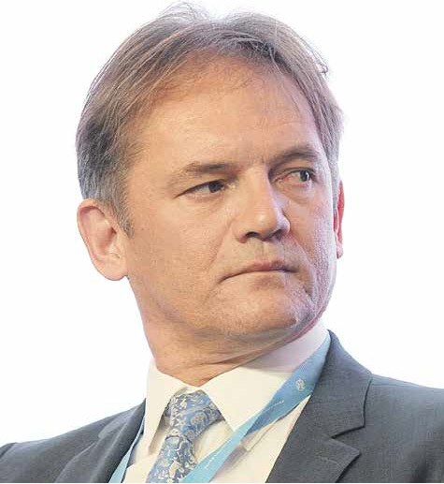
Alan Kuresevic received a Master's in computer science, telecommunication, and information technology from the University of Zagreb. He then joined Astra (today SES) in 1994.
Kuresevic is a managing director of SES Techcom, an SES group company, focused on commercial projects and technology developments in the domain of hybrid satellite/terrestrial connectivity, quantum secure communication and humanitarian disaster response communication. Kuresevic has led several projects and technology developments that have provided the foundation for the company’s new services. He pioneered the development and introduction of the first commercial digital satellite TV broadcast system and is continuing with positioning satellite communication in global connectivity and telecommunication services. Recently, his work has focused on governmental and institutional customers. He works closely with the Luxembourg government, United Nations, ESA, European Commision and other governmental and international organisations.
Alan Kuresevic
Managing Director
SES Techcom

Slide 7
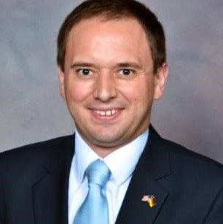
Laurent Jaffart is currently the head of Strategy, Corporate and New Business Development of Airbus Defence and Space for Space Systems. Formerly, he was the head of Constellation and Future solution for Space Systems Marketing and Sales. Jaffart is also member of the Board of Airbus OneWeb Satellites LLC which designs and manufactures constellation satellites, amongst other opportunities. Jaffart leads a trans-national team based in France, Germany and in the UK. The aim of his organisation is to define and implement the strategy for Airbus Space, bringing new solutions and innovation to the market. Jaffart holds a Master's in national resources strategy from the National Defense University in Washington DC USA (2013), two Masters in business administration from the former ESC Reims (Reims Management School - France) and Dublin City University (2002) and a Bachelor of Sciences (Hons) in European Business and Technology from the University of Brighton in the UK (2000).
Laurent Jaffart
Vice President - Head of Strategy, Corporate & New Business Development Space Systems
Airbus Defence and Space

Slide 8
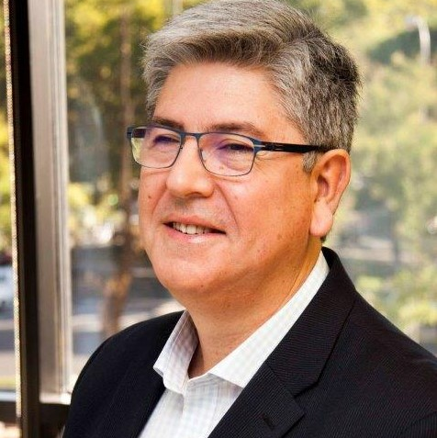
Antonio Abad holds a Master of Sciences in aeronautical engineering from the Polytechnic University of Madrid and is graduated in senior management in the ‘General Management Program (GMP)’ and in ‘Digital Transformation’ from IESE Business School. In addition, he has been professionally recognised, becoming an academician at the International Academy of Astronautics (IAA) and the Academie de l’Air and l‘Espace (AAS). After initiating his professional activities at Telefónica Sistemas in 1989, he has developed his career at HISPASAT in different engineering and management responsibilities. Since 2003 he has served as the Chief Technical Officer of HISPASAT, being responsible for the definition and implementation of satellite systems, launchers, control centres and ground stations. In 2019, he took over the development of the future space infrastructure of HISPASAT, analysing from High Altitude Platforms to Cubesats, Software Defined Satellites, and Constellations.
Antonio Abad Martín
Chief Technical Officer
Hispasat

